Slide 1
Lab 11: Bitwise Operators
CS F111
Authors: CS F111 FDTAs
(Aditya Tailor,
Mitra Shah,
Ronit Kunkolienker)

Slide 2
Introduction
Bitwise operators in C are fundamental tools for manipulating individual bits within variables.
These operators allow you to perform operations at the binary level, which can be useful for tasks such as setting or clearing specific bits, checking if a particular bit is set, or performing bitwise logic operations like AND, OR, XOR, and NOT.
In this tutorial, we will be covering 6 basic bitwise operations:
bitwise AND (&) operator
bitwise OR (|) operator
bitwise XOR (^) operator
bitwise NOT (~) operator
left shift (<<) operator
right shift (>>) operator

Slide 3
Why do we use BITWISE operators?
BITWISE operators offer quite a few advantages such as:
Efficient Memory Usage: Bitwise operators allow us to manipulate individual bits within a variable. This means we can store more information in a smaller amount of space. For example, instead of using an entire integer to store a simple yes/no value, we could use a single bit. This can be particularly useful in systems where memory is at a premium.
Faster Execution: Bitwise operations are typically faster than arithmetic operations. This is because they are simpler for the CPU to perform - they don’t require any complex calculations, just simple setting or clearing of bits. This can lead to significant performance improvements in time-critical code.

Slide 4
continued…
Bit Manipulation: Bitwise operators allow us to manipulate individual bits within a variable. This can be useful in a variety of applications. For example, in graphics programming, individual bits in a color value might represent the red, green, and blue components of the color. With bitwise operators, we can manipulate these components individually. It is also used in cryptography
Bit Masking: Bitwise operators are commonly used for bit masking, which involves setting or retrieving only certain bits of a variable. This can be useful for extracting specific pieces of information from a variable. For example, if we have a byte where each bit represents a different setting in a configuration, we can use a bit mask to extract the value of a specific setting.

Slide 5
Quick Revision!
Before we start with each operator, let’s quickly revise some basics of binary representation of data that we learnt earlier…
Set & Unset bit
We call a bit set if it is 1, and unset if its 0. Eg: 10110 - has 3 set bits and 2 unset bits.
Positioning of bits
We usually start numbering the bits from right to left, assigning the rightmost bit as 0th index and so on. This is called the Little Endian format and most systems nowadays use this. The rightmost bit is called LSB( Least Significant Bit) & leftmost bit is called MSB(Most Significant Bit).

Slide 6
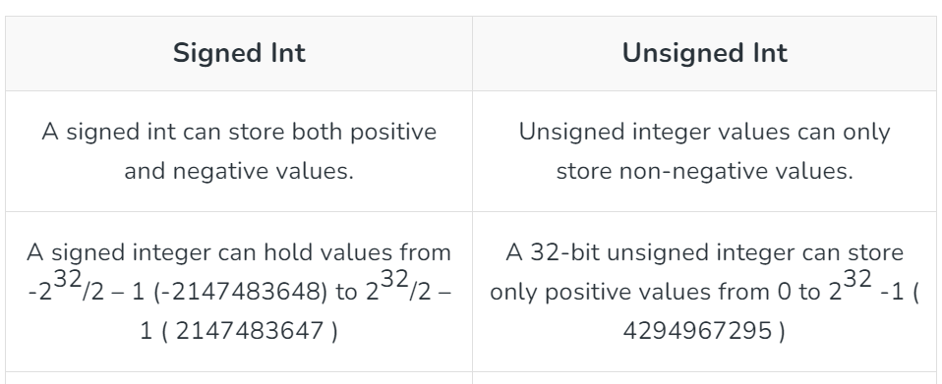
unsigned int data type
unsigned int is used when we want to store only non-negative integers.

Slide 7
continued…
In C, int data type is signed by default
MSB in signed int represents sign:- 0 for positive and 1 for negative numbers.
In unsigned int , all bits represent only magnitude of the number;
unsigned int x = 55;
The binary representation of 55 is: 110111.
So, x is stored as:
00000000 00000000 00000000 00110111
Most Significant Bit b₃₁
Least Significant Bit b₀

Slide 8
BITWISE AND (&) OPERATOR
The BITWISE ‘&’ operator performs the logical ‘AND’ operation between the corresponding bits of 2 operands, and returns the answer.
It returns 1, if both the bits are 1, else it returns 0 in all other cases.
Eg: Let’s say we have 2 variables a and b, with the following values-
a=6, b=4
Their binary representation is as follows:
a=0110, b=0100
Now if we perform bitwise AND on the 2 variables, we will get the following result:
a 0110
b 0100
a&b 0100
And we know that 0100 in binary is equivalent to 4 in decimal. Hence a & b == 4

Slide 9
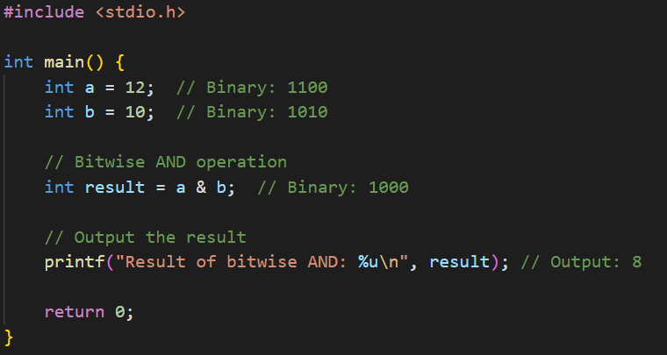

Slide 10
BITWISE OR( ‘|’ ) OPERATOR
The Bitwise | operator performs the logical OR operation between the corresponding bits of 2 operands.
It returns 1 if at least one of the bits is 1.
It returns 0 only if both bits are 0.
For example, let’s consider 2 variables c and d with values 6 and 4 respectively.
The binary representation of c (6) is 0110.
The binary representation of d (4) is 0100.
c 0110
d 0100
c|d 0110
Hence c | d = 0110
The binary number 0110 is equivalent to 6 in decimal.
Hence, c | d equals 6.

Slide 11
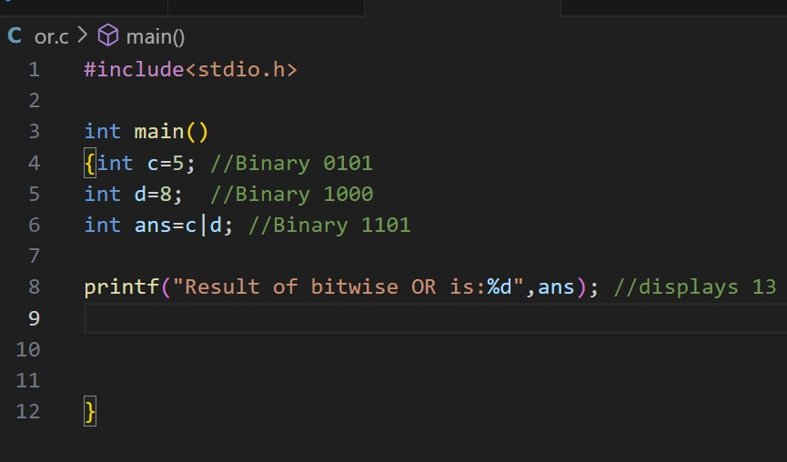

Slide 12
BITWISE XOR(‘^’) OPERATOR
The Bitwise ^ operator performs the logical XOR (exclusive OR) operation between the corresponding bits of 2 operands.
It returns 1 if the bits are different (one is 1 and the other is 0).
It returns 0 if the bits are the same (both 0 or both 1).
For example, let’s consider 2 variables g and h with values 6 and 4 respectively.
The binary representation of g (6) is 0110.
The binary representation of h (4) is 0100.
If we perform the bitwise XOR operation on these 2 variables, we get:
g ^ h = 0010
The binary number 0010 is equivalent to 2 in decimal.
Hence, g ^ h equals 2.
g 0110
h 0100
g^h 0010

Slide 13
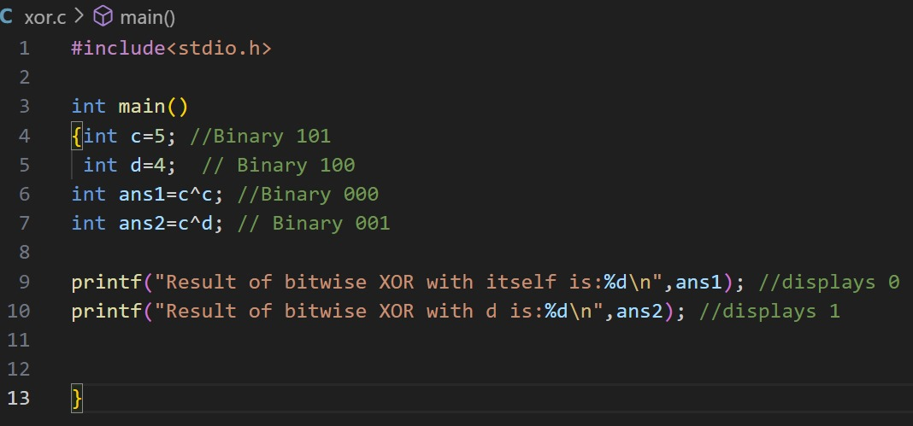
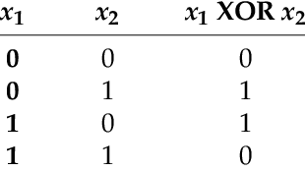

Slide 14
the bitwise shift operators
a<<n
(Bitwise left-shift)
Returns: a with each bit shifted left by n bits
The rightmost n bits are now clear (0)
a>>n
(Bitwise right-shift)
Returns: a with each bit shifted right by n bits
The leftmost n bits are now clear
⚠ n must be a positive integer, otherwise the result becomes unpredictable

Slide 15
visualising bitshifts
Think of the left-shift a<<n as n 0s being “pushed” from the right into the binary representation of the number a.
The right-shift a<<n is like n 0s being “pushed” from the left into the binary representation of the number a.
Let’s try evaluating:
(unsigned int)24<<3
If 24 is an unsigned integer (32-bit), then in binary it is:
0000 0000 0000 0000 0000 0000 0001 1000
b31 b30 b29 b28 b27 b26 ………………………..……………………………..………………………………………………………………………………….…b4 b3 b2 b1 b0

Slide 16
24<<3: Step 0
0
0
0
0000 0000 0000 0000 0000 0000 0001 1000
b31 b30 b29 b28 b27 b26 ………………………..……………………………..………………………………………………………………………………….…b4 b3 b2 b1 b0
Decimal Tracker
0 x 2⁰ + 0 x 2¹ + 0 x 2² + 1 x 2³ + 1 x 2⁴ + 0 x 2⁵ + 0 x 2⁶ + 0 x 2⁷ + … + 0 x 2³¹
= 8 + 16
= 24

Slide 17
24<<3: Step 1
0
0
0000 0000 0000 0000 0000 0000 0011 0000
b31 b30 b29 b28 b27 b26 ………………………..……………………………..………………………………………………………………………………….…b4 b3 b2 b1 b0
Decimal Tracker
0 x 2⁰ + 0 x 2¹ + 0 x 2² + 0 x 2³ + 1 x 2⁴ + 1 x 2⁵ + 0 x 2⁶ + 0 x 2⁷ + … + 0 x 2³¹
= 16 + 32
= 48

Slide 18
24<<3: Step 2
0
0000 0000 0000 0000 0000 0000 011 00000
b31 b30 b29 b28 b27 b26 ………………………..……………………………..………………………………………………………………………………….…b4 b3 b2 b1 b0
Decimal Tracker
0 x 2⁰ + 0 x 2¹ + 0 x 2² + 0 x 2³ + 0 x 2⁴ + 1 x 2⁵ + 1 x 2⁶ + 0 x 2⁷ + … + 0 x 2³¹
= 32 + 64
= 96

Slide 19
24<<3: Step 3
0000 0000 0000 0000 0000 0000 11 000000
b31 b30 b29 b28 b27 b26 ………………………..……………………………..………………………………………………………………………………….…b4 b3 b2 b1 b0
☑
Decimal Tracker
0 x 2⁰ + 0 x 2¹ + 0 x 2² + 0 x 2³ + 0 x 2⁴ + 0 x 2⁵ + 1 x 2⁶ + 1 x 2⁷ + … + 0 x 2³¹
= 64 + 128
= 192 ☑

Slide 20
shift by n bits ≣ shift by 1 bit n times
Notice that to find 24<<3, we have shifted 24 left 3 times, 1 bit at a time.
That is to say, we could have obtained the same result using:
(((24<<1)<<1)<<1) or
((24<<1)<<2) or
((24<<2)<<1)
a<<(n₁+n₂) is (a<<n₁)<<n₂

Slide 21
left-bitshift multiplies by 2
Observe how the (decimal) value of the expression changes with every left bitshift.
24<<1 == 48
24<<2 == 96
24<<3 == 192
Left bitshift is multiplication by 2.
a<<1 is 2a

Slide 22
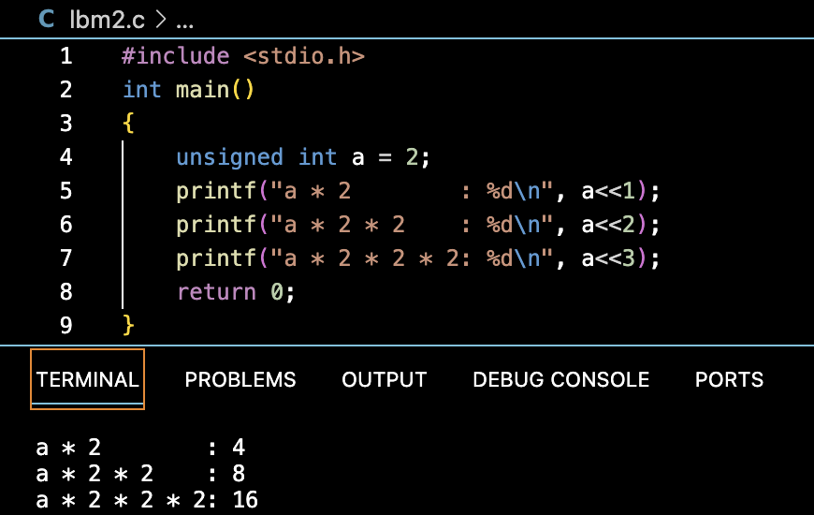
left bitshift multiplies by 2

Slide 23
…and the right-bitshift?
The last binary bit is the remainder after dividing by 2.
(24)₁₀ = (0000 0000 0000 0000 0000 0000 0001 1000)₂.
(25)₁₀ = (0000 0000 0000 0000 0000 0000 0001 1001)₂
After shifting right the last bit is lost.
(24>>1)₁₀ = (0000 0000 0000 0000 0000 0000 00001 100)₂ = (12)₁₀
(25>>1)₁₀ = (0000 0000 0000 0000 0000 0000 00001 100)₂ = (12)₁₀
So (2k>>1) and ((2k+1)>>1) both give k.
Right-bitshift is floor division by 2.
a>>1 is ⌊a/2⌋

Slide 24
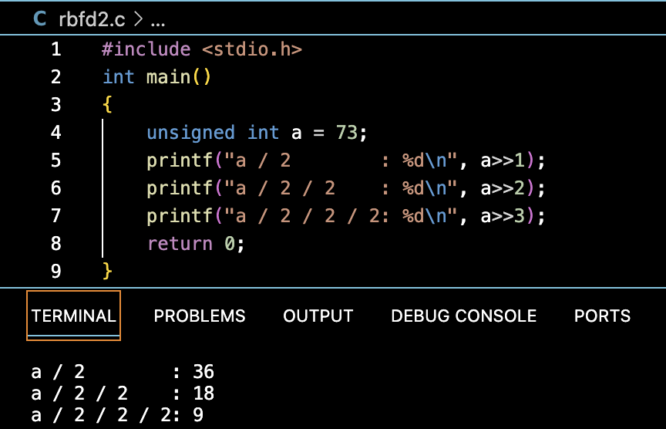
…and the right-bitshift?

Slide 25
BITWISE NOT(‘~’) OPERATOR
The Bitwise ~ operator carries out a logical NOT operation on each bit of a number.
This operation flips the bits of the number, meaning 0 turns into 1 and 1 turns into 0.
For instance, let’s take an unsigned variable e with a value of 5.
The binary representation of e (5) is 0101.
When we apply the bitwise NOT operation to this variable, we get:
~e = 1010
In many programming languages, including C, the bitwise NOT operation for signed numbers is implemented using the 2’s complement representation. This topic will be covered in the next semester if you are a CS/electronics student.
However, in this discussion, we are only covering the bitwise NOT operation for unsigned integers.

Slide 26
continued…
Since unsigned int are 32-bit integers in C the actual binary representation of 5 is 00000000000000000000000000000101. So, ~e results in flipping each bit of this 32-bit number, which gives 11111111111111111111111111111010.
Basically, we just need to add enough zeroes in front to make it 32-bit.
This binary number is equivalent to 4294967290 in decimal.

Slide 27
